Slide 1
MGMT298D
Science and Strategy of AI
Week 1
Course Introduction;
Foundations of Machine Learning
Auyon Siddiq UCLA Anderson School of Management
(Phones and laptops away please!)

Slide 2
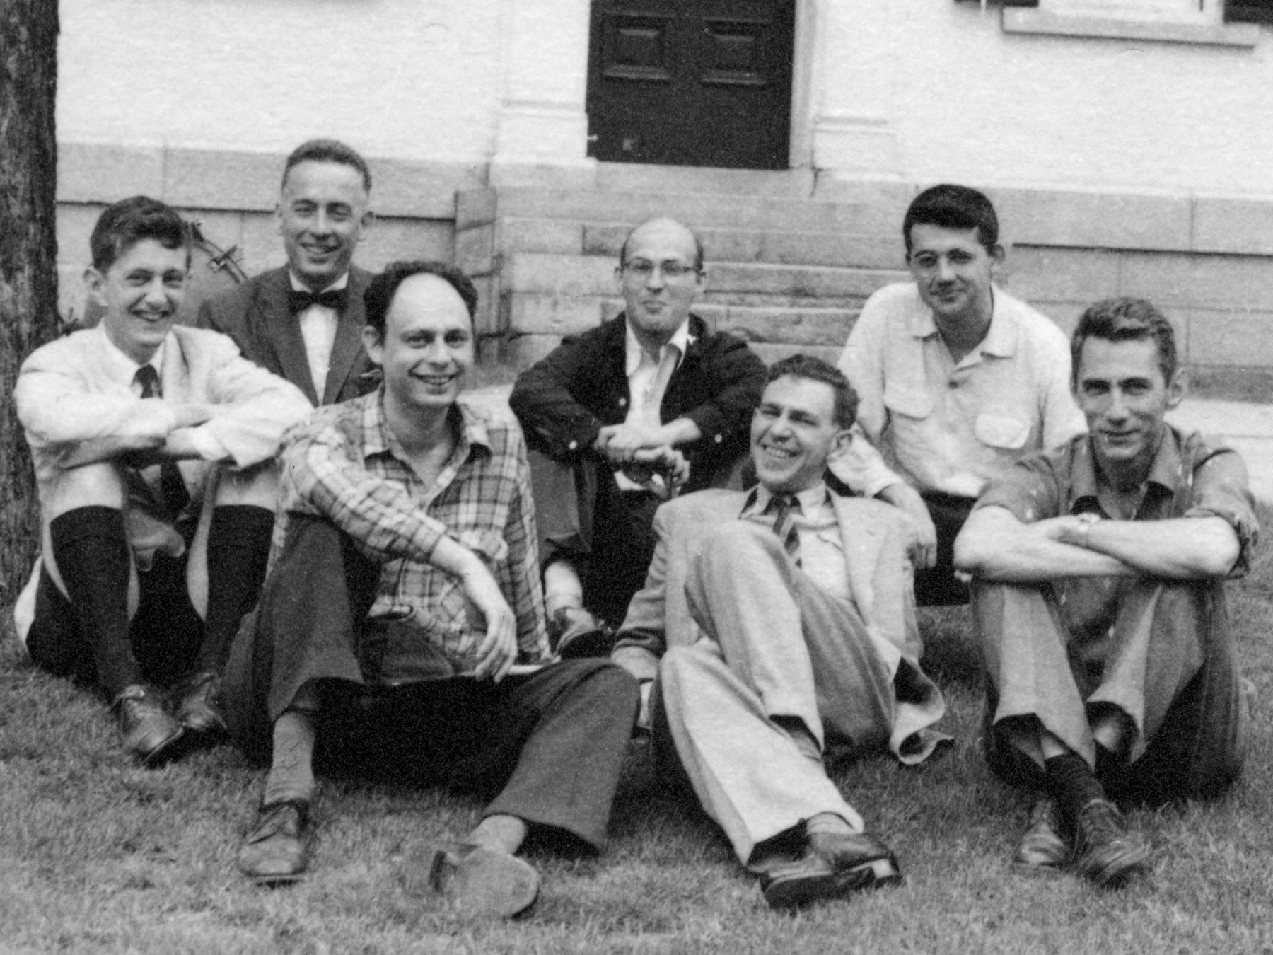
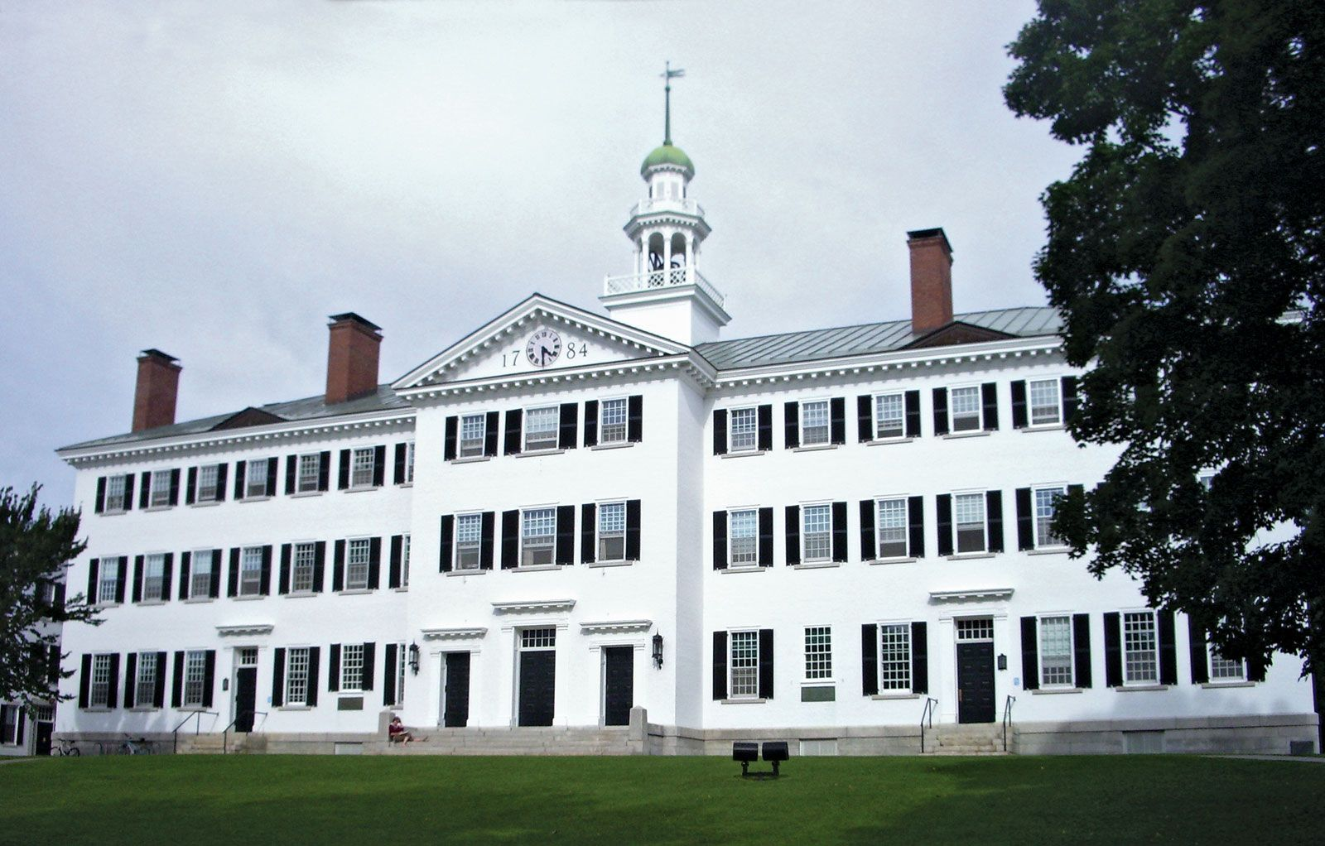
When Did "Artificial Intelligence" Begin?
1956: Dartmouth Conference — John McCarthy proposes a conference and coins the term
John McCarthy
Marvin Minsky
Claude Shannon
https://spectrum.ieee.org/dartmouth-ai-workshop
Notes:
John McCarthy — back row, far right. He was a young mathematics professor at Dartmouth College at the time, and was the primary organizer of the workshop. He later moved to MIT and then Stanford.
Claude Shannon — front row, far right. He was at Bell Labs (Bell Telephone Laboratories), where he had done his groundbreaking work on information theory. He also held a position at MIT.
Marvin Minsky — back row, second from right (next to McCarthy). He was a junior fellow at Harvard at the time, having recently completed his PhD at Princeton. He soon after joined MIT, where he co-founded the AI Lab in 1959.

Slide 3
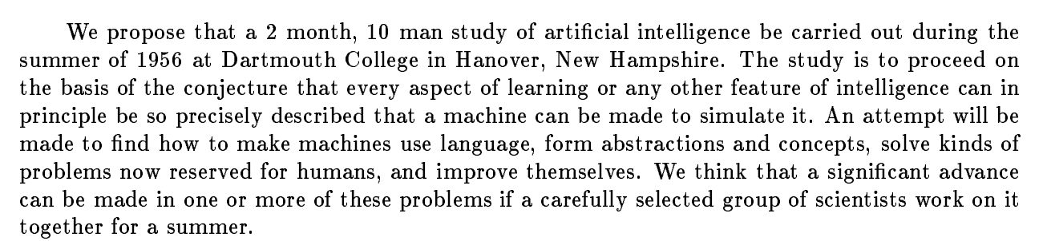
When Did "Artificial Intelligence" Begin?
McCarthy’s research proposal:
http://jmc.stanford.edu/articles/dartmouth/dartmouth.pdf

Slide 4
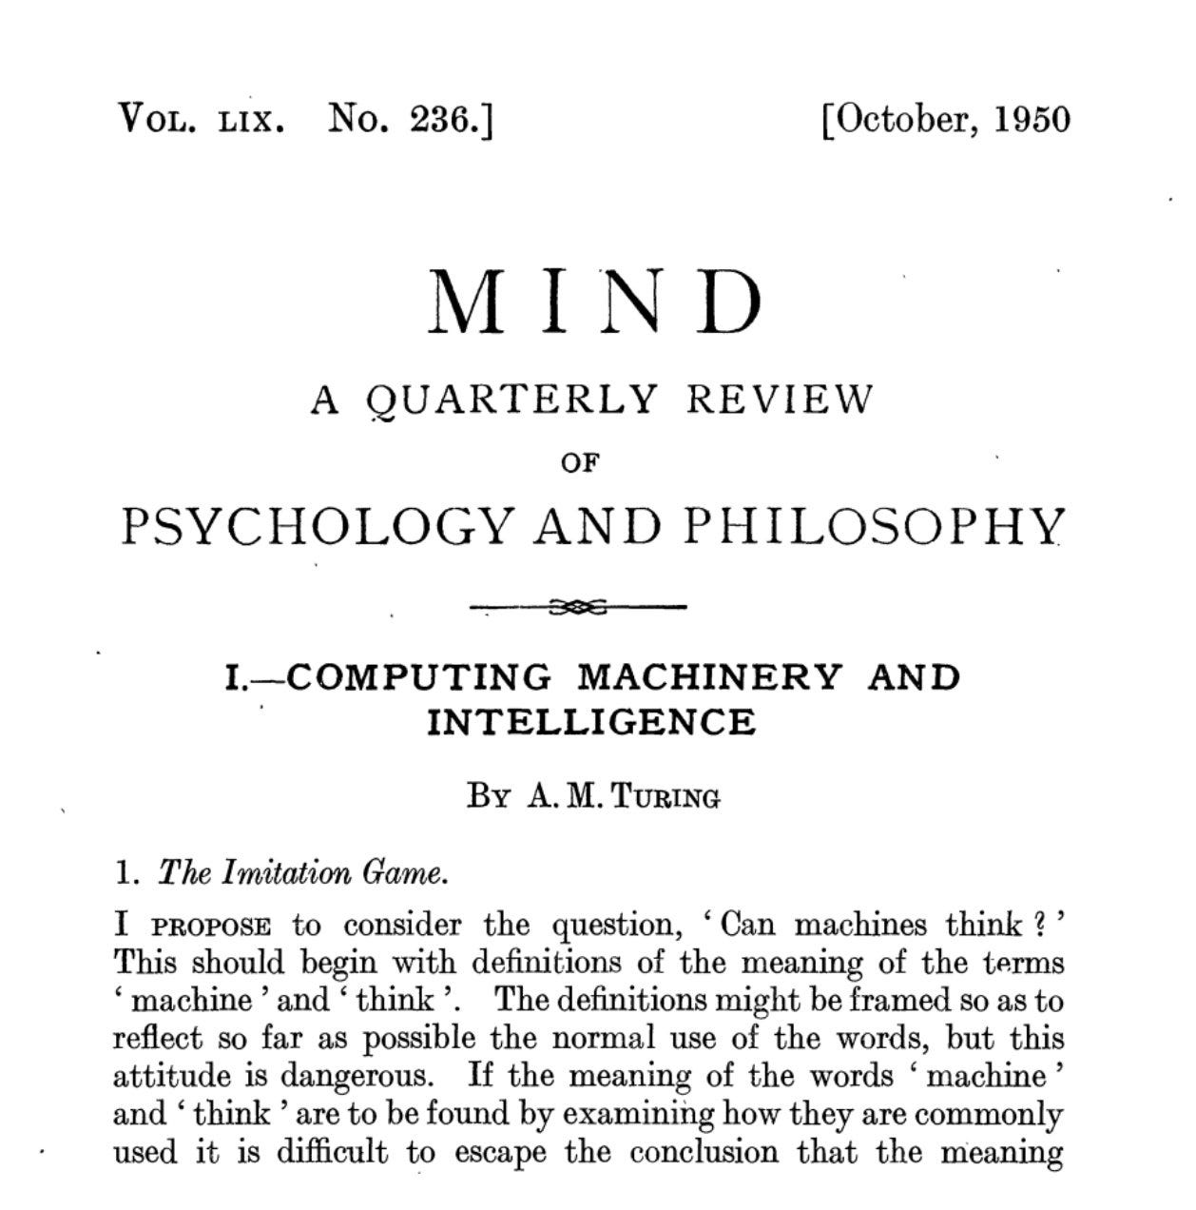


Slide 5
Confident Predictions!
"Machines will be capable of doing any work a man can do."
— Herbert Simon, 1965
"Within a generation... the problem of creating 'artificial intelligence' will substantially be solved."
— Marvin Minsky, 1967
"In 3 to 8 years we will have a machine with the general intelligence of an average human being."
— Marvin Minsky, 1970

Slide 6
Three Major Waves of AI
Artificial Intelligence
Traditional
(1960s - 90s)
Logic-based AI
“If then”
IF TIME > 3pm AND TIME < 7pm THEN TRAVEL_TIME = 60 minutes
Notes:
Traditional: If then – limited because of time/resources, new scenarios
“We know more than we can tell” – Polanyi’s paradox (we cannot explain our knowledge)

Slide 7
Three Major Waves of AI
Machine Learning
Training examples
Structured (tabular) data
ML model
Class (e.g., 0 or 1)
Number
Time of day Origin Destination IsRaining
Travel Time

Slide 8
Three Major Waves of AI
Traditional
Machine Learning
Artificial Intelligence
Machine Learning

Slide 9
Three Major Waves of AI
Deep Learning
Representations
DL model
Class (e.g., 0 or 1)
Number
Unstructured data
(text, images)
Traffic camera images Live accident reports
Travel Time
Notes:
Deep learning is all about representations!!!! Manual representations limit the reach of traditional ML Deep learning unleashed by 1) new algorithms 2) massive data 3) massive compute (from GPUs)

Slide 10
Three Major Waves of AI
Traditional
Machine Learning Deep Learning
Artificial Intelligence
Machine Learning
Deep Learning
Notes:
Generative AI

Slide 11
Three Major Waves of AI
Generative AI
Output unstructured data
Unstructured data
(text, images)
Gen AI model
Unstructured data
(text, images)
Traffic camera images Live accident reports Time of day Origin Destination IsRaining
Voice navigation
“There's a 20-minute delay on I-10 due to an accident near exit 4A.”
Notes:
Generative AI

Slide 12
Three Major Waves of AI
Traditional
Machine Learning Deep Learning
Generative AI
Artificial Intelligence
Machine Learning
Deep Learning
Gen AI
Notes:
Traditional: If then – limited because of time/resources, new scenarios
“We know more than we can tell” – Polanyi’s paradox (we cannot explain our knowledge)
Deep learning is all about representations!!!! Manual representations limit the reach of traditional ML Deep learning unleashed by 1) new algorithms 2) massive data 3) massive compute (from GPUs) Generative AI

Slide 13
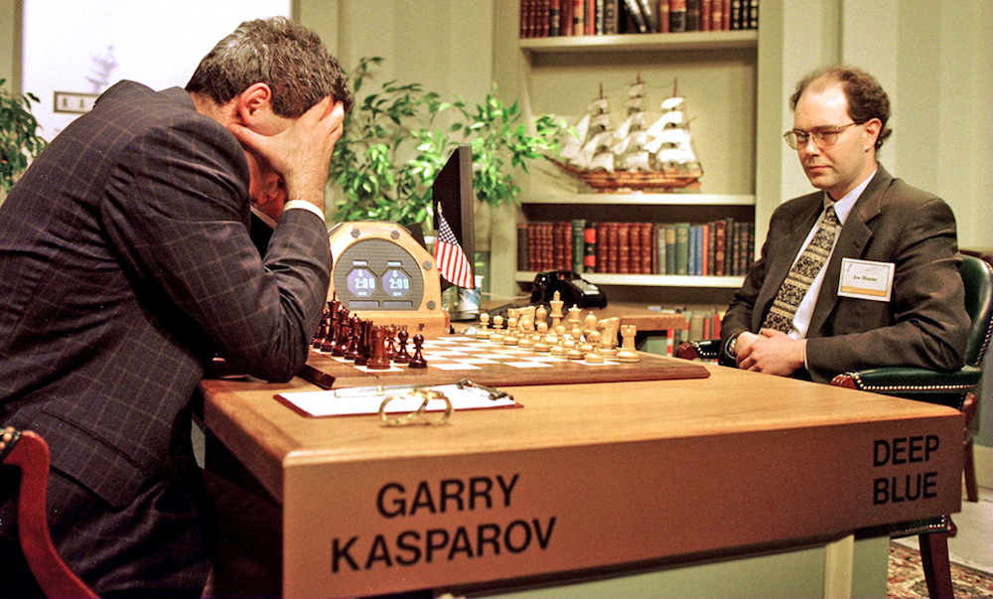
Deep Blue (1997)

Slide 14
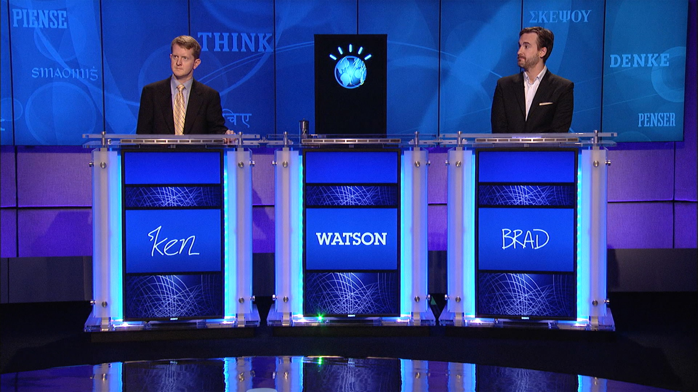
IBM Watson (2011)

Slide 15
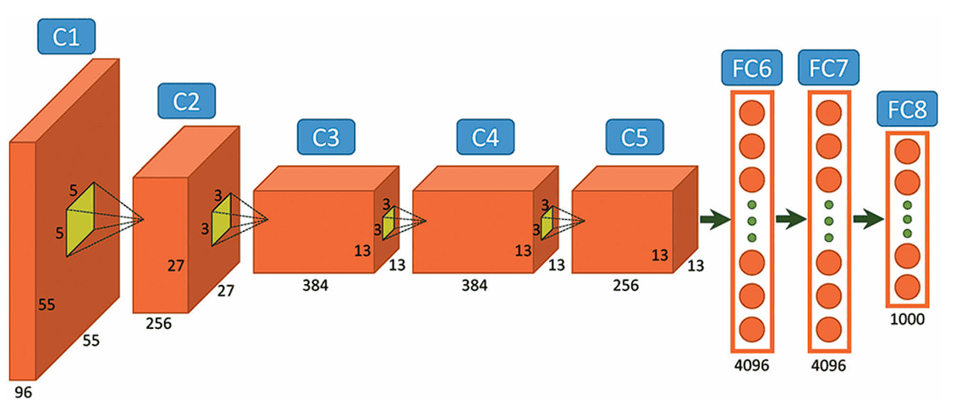
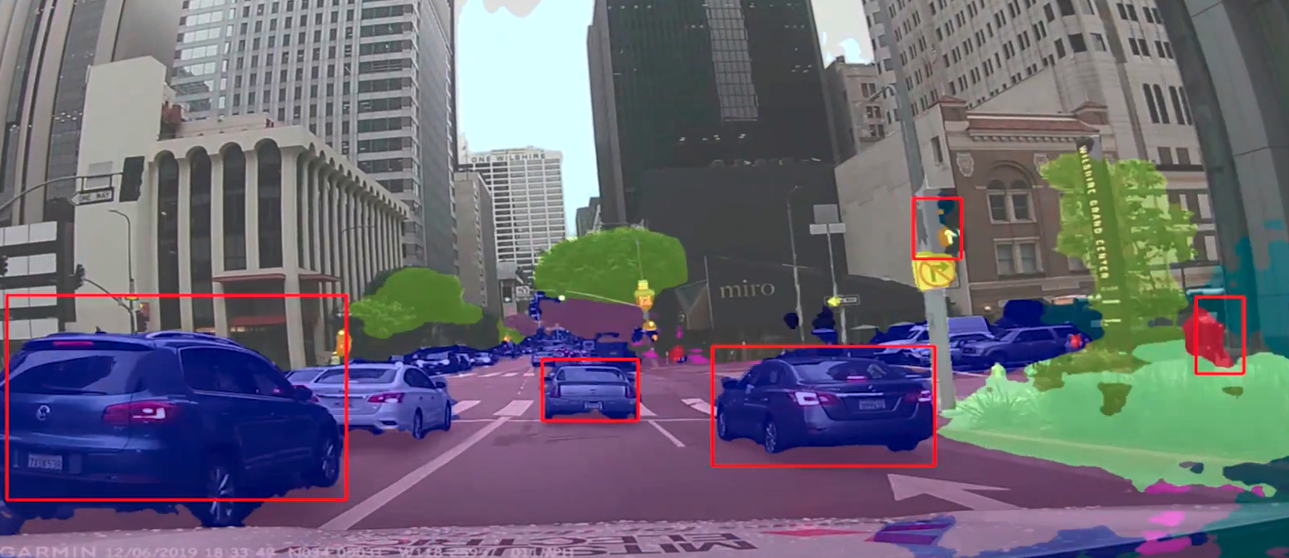

AlexNet (2012)

Slide 16

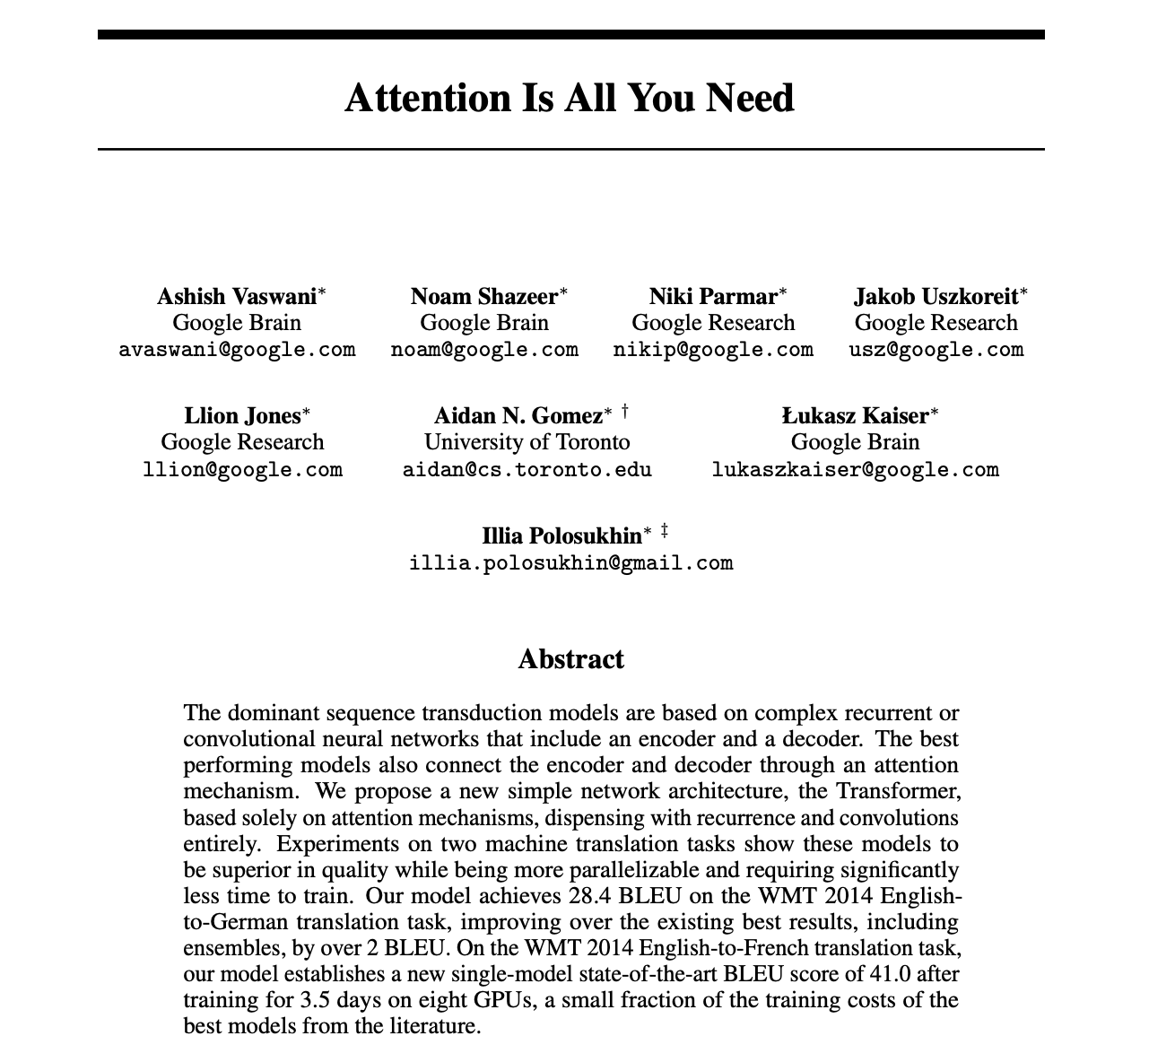

Transformers (2017)

Slide 17

ChatGPT (2022)

Slide 18
So what is this course about?
A wide lens survey core machine learning and AI models
Tech-forward: understand how the technology works and leverages data; explore some implementations in Python and in simulations
Gentle on math, heavy on intuition
We will get technical to build deep understanding – goal is to massively expand your vocabulary around ML and AI

Slide 19
Who is this course for?
Non-technical leaders (consultants, PMs, analysts) who are curious about how ML/AI models work to extract value from data
“Do I need to invest in technical knowledge?”
Precise understanding is important for building true confidence in AI topics: When to deploy, what it can/can't do, etc
Credibility with technical staff, facilitates leading and collaboration
Differentiation in the job market
Complementary to other Anderson courses
It is fun

Slide 20
Course Roadmap
WEEKS 1–3
Machine
Learning
Goal: Understand how to deploy ML models to make predictions/decisions based on rich data
WEEKS 4–7
Deep
Learning
Goal: Build intuition on how complex AI models extract “meaning” from numeric, text, and image data
WEEKS 8–10
Product
Sprint
Goal: Prototype, publish, and pitch an AI-powered web app

Slide 21
Course Roadmap
WEEKS 1–3
Machine
Learning
Goal: Understand how to deploy ML models to make predictions/decisions based on rich data
Overview of the ML “pipeline” – from data to predictions
State-of-the-art prediction models used in industry and best practices for deployment Algorithms for data-driven decision making in dynamic environments

Slide 22
Course Roadmap
WEEKS 4–7
Deep
Learning
Goal: Build intuition on how complex AI models extract “meaning” from numeric, text, and image data
Overview of neural network architecture and training algorithms How massive networks transform language and image data to extract meaning Best practices for AI deployment Economics of building and using AI

Slide 23
Course Roadmap
WEEKS 8–10
Product
Sprint
Goal: Prototype, publish, and pitch an AI-powered web app
Work in teams to prototype a simple AI-powered app and publish it online
Use AI as software developer – you focus on the idea and design Top teams will pitch in Week 10
Showcase your skills and keep a souvenir from the course

Slide 24
Important AI topics we won’t cover as much
How to best use LLMs and agents
- Covered in AI Agents for Managers (Schubert)
- But we will still use LLMs during product sprint
Industry-by-industry survey of AI adoption and strategy / leadership and management of AI
- Easton courses (Khormae, Null, Holloway)
- We will still touch on deployment
Goal is to understand the science better so we can make strategic decisions

Slide 25
Assessments
Seven assignments (Individual)
Usually last ~1 hour of each class to work on these
Completely non-code based – we’ll use custom dashboards
Explore models and answer 3-5 questions in a document and submit on BruinLearn by the end of the day (5pm)
AI product prototype (In groups of 1, 2 or 3)
Based in Python and HTML but vibe-coded with AI, details to come in Week 8

Slide 26

Google Colaboratory
We will often look at Python code together to see how ML/AI models are actually implemented The goal is not to fixate on coding but to understand the general AI pipeline
Google’s Colaboratory is an amazing free resource for implementing AI models in Python → entirely browser-based and no need for local installations on your laptop
You will need any Google/Gmail account to access

Slide 27
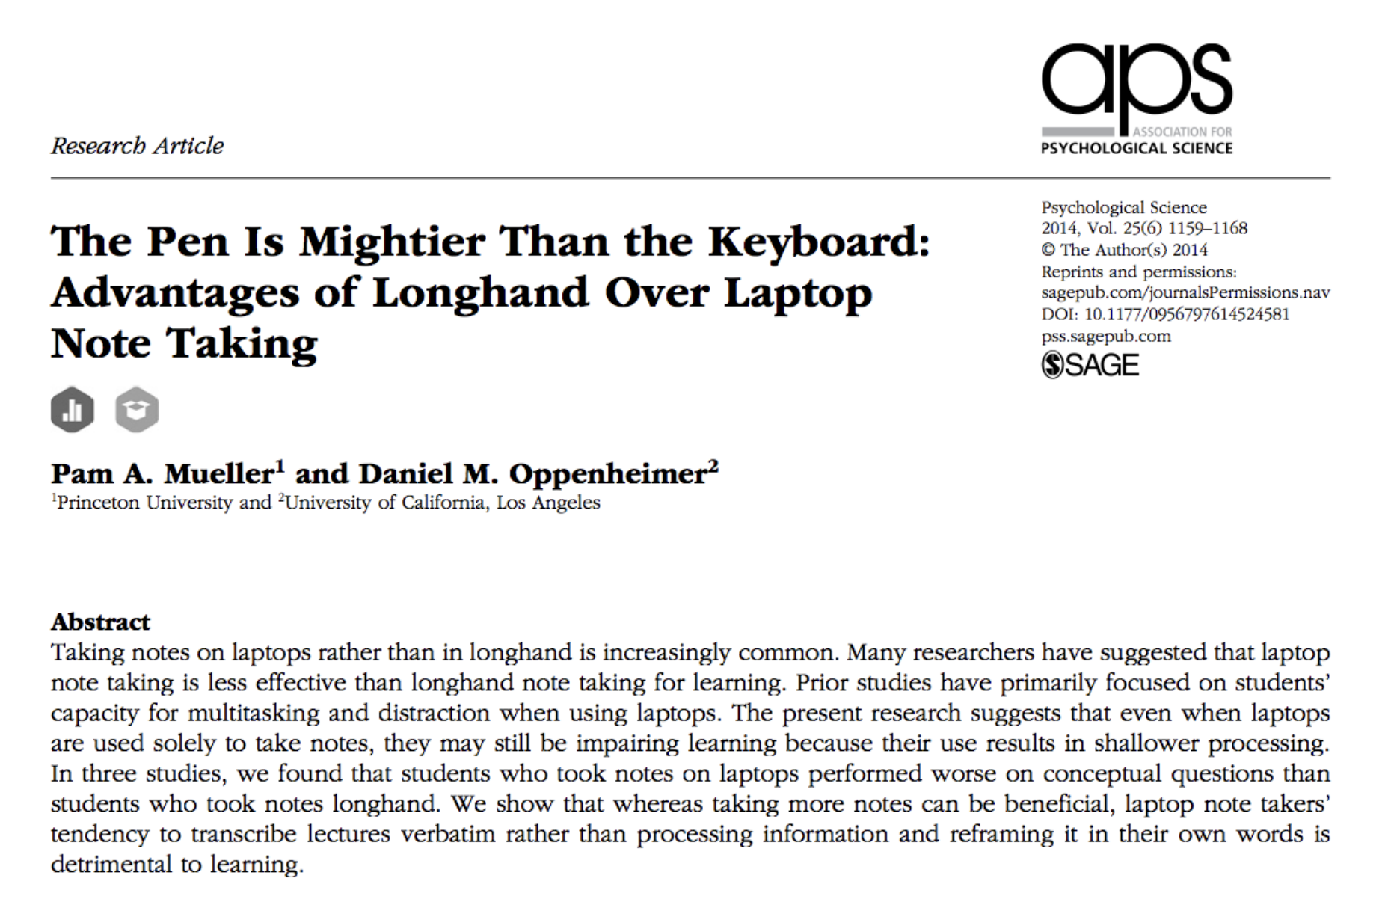
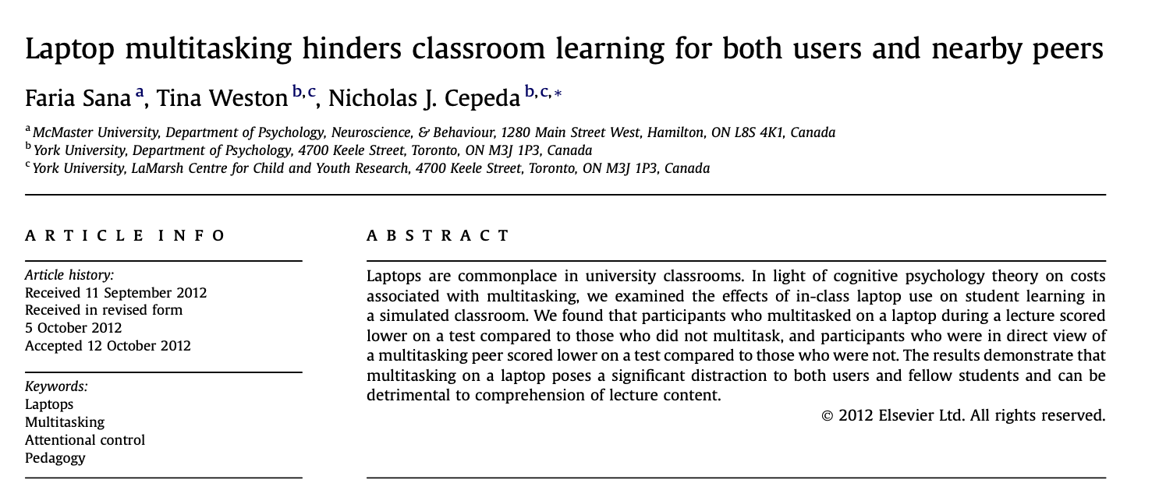
Tech policy
Laptops in back row only, except for during Colab or in-class assignment components
No phones
Mueller and Oppenheimer (2014) handwriting notes improves retention
Sana et al (2012) “second-hand distraction”

Slide 28

(My 3-week old enjoying some crayons)

Slide 29
Course Roadmap
WEEKS 1–3
Machine
Learning
Goal: Understand how to deploy ML models to make predictions/decisions based on rich data
WEEKS 4–7
Deep
Learning
Goal: Build intuition on how complex AI models extract “meaning” from numeric, text, and image data
WEEKS 8–10
Product
Sprint
Goal: Prototype, publish, and pitch an AI-powered web app

Slide 30
Demand Forecasting at H&M
Case Handout

Slide 31
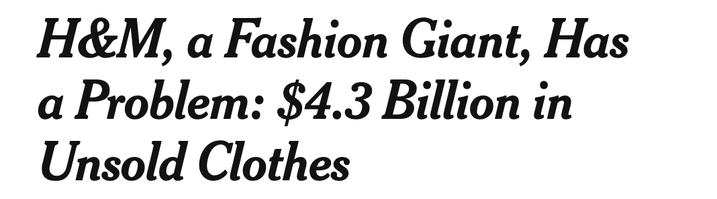
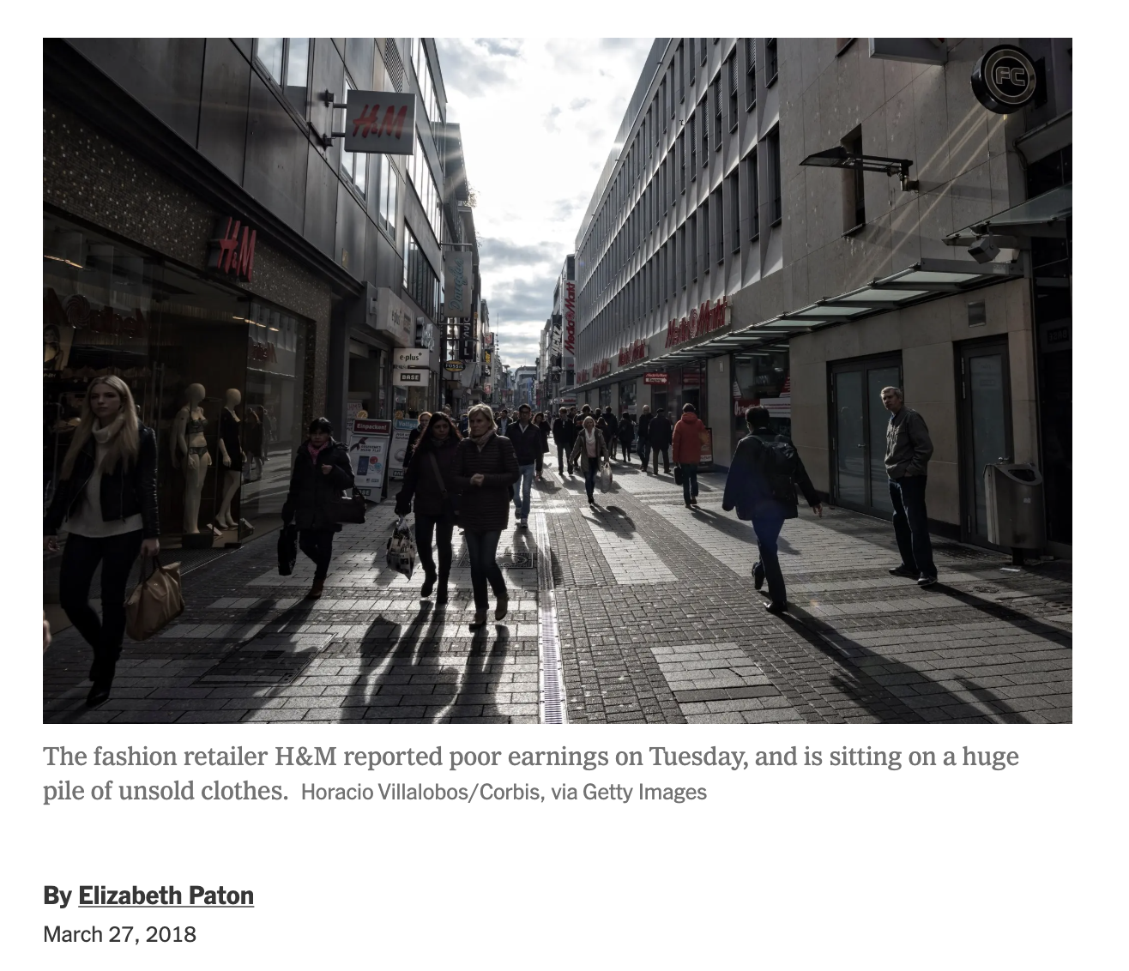
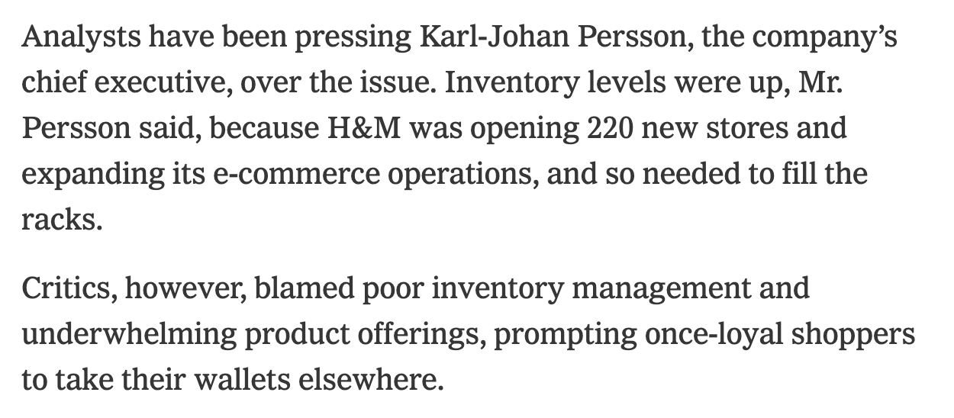

Slide 32
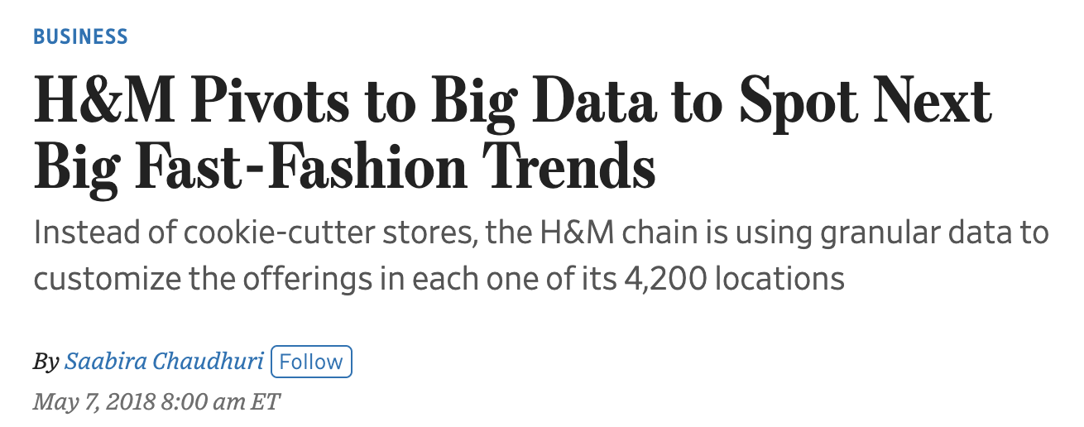
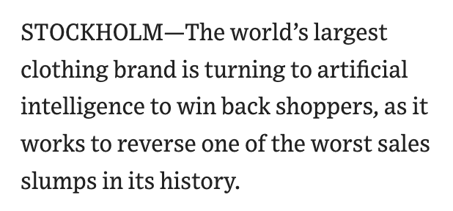

Slide 33
Discussion

Slide 34
Machine Learning

Slide 35

What is Machine Learning?
Branch of artificial intelligence focused on prediction
Mostly uses structured, tabular data
Extension of statistics, but we care much less about parameter estimates, confidence intervals, p-values – just want to make good predictions!

Slide 36
What is a Model?
Most standard setup: Develop using training examples (input and output data pairs), and produce a prediction Two types:
Regression
Predict a number “Sales next month?”
Classification
Predict a category “Will this shopper make a purchase?”
Input data
Output data
Price Color Month Product category
Some complicated relationship
Sales
ML models try to approximate this

Slide 37
Data
H&M sales data: Each row = one product-month
product id | price | month | category | sales
1 | $42.50 | January | T-Shirt | 110
1 | $38.00 | February | T-Shirt | 88
2 | $55.00 | January | T-Shirt | 185
2 | $55.00 | February | T-Shirt | 65
... | ... | ... |  | ...
features
label
First ML model? Linear regression!

Slide 38
Linear Regression

Slide 39
Linear Regression
(General linear regression model)
ŷ = β₀ + β₁x₁ + β₂x₂ + ... + β_{d}x_{d}
(An example model)
sales = β₀ + β₁ * price + β₂ * onSale
x: features
y: label
β: model “weights”
How do we find the best weights?

Slide 40
Model Training: Finding “Best” Weights
Find β values that minimize a loss function:
actual sales
predicted sales
Measures the mismatch between model predictions under β and the true labels
Finding the best β is an optimization problem
Whenever you hear “model training” think “finding optimal or good enough weights”

Slide 41
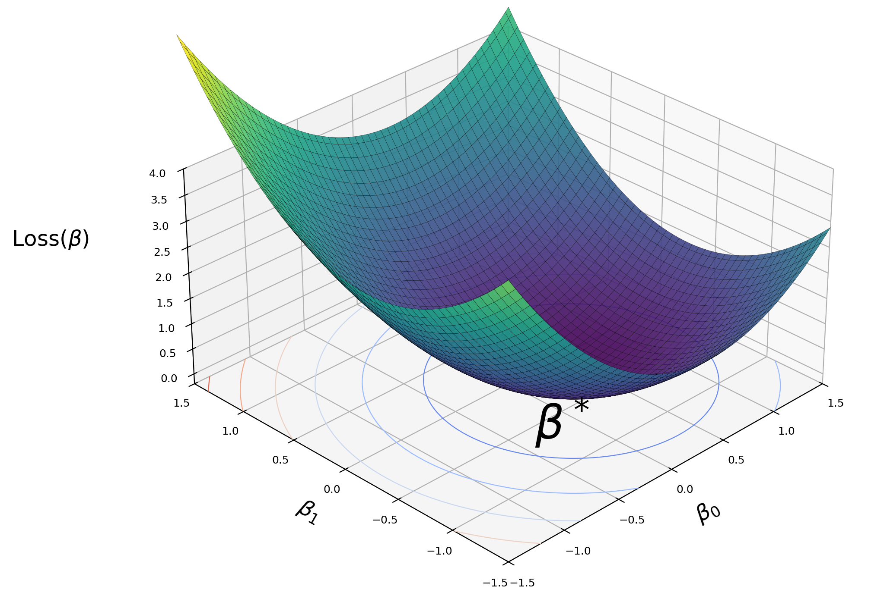
Loss Surface
Optimal weights β* found by minimizing the loss function
Lots of Python packages etc. to handle this -- we will skip details for now

Slide 42
Making Predictions
With trained coefficients, prediction is simple arithmetic:
Trained Model:
sales = 850 - 15 * Price + 50 * onSale
Example Calculation:
Given: price = $38, onSale = 1:
sales = 850 + (-15)(38) + (50)(1)
= 850 - 570 + 50 = 330 units

Slide 43
Evaluating Prediction Error
RMSE: “Root Mean Squared Error”: average (actual - predicted)², then square-root it
MAE: “Mean Absolute Error”: average of |actual - predicted| across all observations. Easier to interpret: "on average, we're off by X units"

Slide 44
Best Practices: Train/Test Split
Test set represents future, unseen data
Detects overfitting (memorization vs learning)
Test set is locked until final evaluation
Training Data (80%)
Test Data (20%)
↓
Find β weights
Evaluate prediction errors once

Slide 45

15-min Break

Slide 46
Feature Engineering

Slide 47
Feature Engineering
What to do when features are limited?
Feature engineering: Use existing features to create new features!
Example: We observe prices for each product-month. We can create new variable %PriceChange_{t} = (Price_{t} – Price_{t-1}) / Price_{t-1}
What other new features would make sense for H&M sales prediction?

Slide 48
Feature Engineering: Proceed with Caution
Feature engineering allows for richer models by increasing predictors But can risk overfitting depending on how many features we have vs. data
Overfitting: Model is too complex for available data, fits to random noise instead of extracting real signal
Warning signs: test error much higher than training error

Slide 49
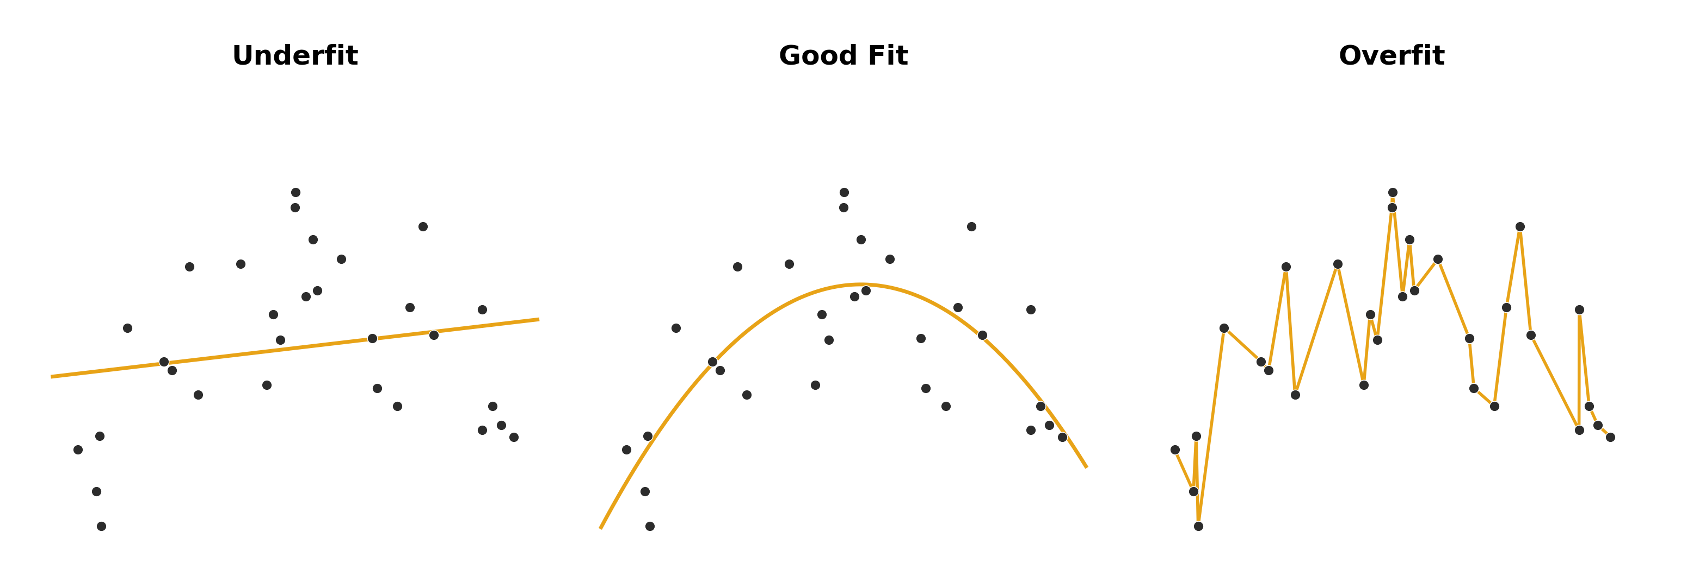

Slide 50
Regularization:
Preventing Overfitting

Slide 51
Regularization
Regularization refers to any method that aims to limit model complexity
In linear regression, regularization means shrinking large model weights

Slide 52
Baseline: Standard Linear Regression
Regularization refers to any method that aims to limit model complexity
In linear regression, regularization means shrinking large model weights

Slide 53
LASSO Regression
Feature | λ=0 | λ=1 | λ=10 | λ=100
price | -2.5 | -2.3 | -1.8 | -0.9
January | +3.2 | +2.9 | +1.5 | 0
February | +45 | +42 | +30 | +12
black | +0.3 | +0.1 | 0 | 0
striped | -0.8 | -0.2 | 0 | 0
Most predictive features survive

Slide 54
Best Practices: Feature Standardization
Problem: Features have different scales
Feature | Range | Units
price | $10 – $150 | dollars
productAge | 1-10 | months
Rescaling formula:
z = (x - mean) / std_dev
Example:
Feature | Before (raw) | After (scaled)
price | 42.50 | 0.15
productAge | 5 | 0.4
All features now have mean=0, std=1 Makes LASSO penalty apply “more evenly” across variables
Also allows for direct comparison of coefficient weights

Slide 55
Ridge Regression
Ridge vs LASSO (λ=10):
Feature | No Reg | LASSO | Ridge
Price | -2.5 | -1.8 | -2.1
January | +3.2 | +1.5 | +2.6
February | +45 | +30 | +39
black | +0.3 | 0 (removed) | +0.2 (kept)
striped | -0.8 | 0 (removed) | -0.6 (kept)
Does not fully eliminate variables from model

Slide 56
ElasticNet: Best of Both Worlds
Ridge
LASSO
λ - how strongly to regularize (a positive number) α - how strongly the regularization leans toward LASSO vs. Ridge (between 0 and 1)

Slide 57

Cross-Validation
We choose best penalty parameters through cross-validation

Slide 58
Regularization Summary
LASSO
Ridge
ElasticNet
Feature Selection
Feature Selection
Feature Selection
✓ Yes (zeros)
✗ No
✓ Partial
Correlated Features
Correlated Features
Correlated Features
Struggles
✓ Excellent
✓ Good
Best For
Best For
Best For
Feature selection
Correlated features
General purpose
Notes:
LASSO arbitrarily picks one out of many correlated features, but may be unstable Ridge regression keeps all of the correlated features but shrinking the weights, sort of an averaging effect

Slide 59
A Standard ML Pipeline for Linear Regression
Organize and clean data, choose features (x) and label (y)
Engineer new features if needed based on context
Standardize features, create training/test split
Train model on training data; use cross validation for regularization parameters if using LASSO/Ridge/ElasticNet
Report errors

Slide 61
In-Class Assignments
How this will work:
Each week’s in-class assignment has a web frontend on top of a Python backend → avoids the need to deal with code so you can focus on concepts Questions available on BruinLearn as a PDF, add your responses and submit
Due 5pm the day of class, with two missed assignments allowed
Individual, mostly graded “on completion”

Slide 62
Assignment 1

Slide 63
Glossary (1/2)
Machine learning
A branch of AI where models learn patterns from data instead of being explicitly programmed with rules.
Features (x)
The input variables a model uses to make predictions, such as price or discount rate.
Label (y)
The output variable the model is trying to predict, such as units sold.
Weights
Learned numerical values that determine how much each feature influences the prediction.
Training
The process of finding the best model weights by minimizing prediction error on known data.
Loss function
A formula that measures how wrong the model's predictions are; training tries to make this as small as possible.
Overfitting
When a model memorizes the training data (including noise) and performs poorly on new data.

Slide 64
Glossary (2/2)
Train/test split
Dividing data into a training set (to learn from) and a held-out test set (to evaluate on), so we can evaluate performance and detect overfitting.
Feature engineering
Creating new input variables from existing ones to help the model capture more complex patterns.
Regularization
Any technique that penalizes model complexity to prevent overfitting, such as LASSO or Ridge.
LASSO (L1)
A regularization method that adds a penalty based on the absolute value of coefficients, which can zero out weak features entirely.
Ridge (L2)
A regularization method that adds a penalty based on the squared value of coefficients, shrinking all of them but keeping them nonzero.
Cross-validation
A technique for evaluating model performance by rotating which portion of the data is used for testing, used to choose hyperparameters like the regularization strength.

